Slide 2
Active contours : Goal

Slide 3
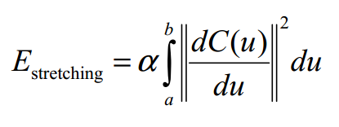
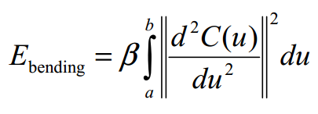
Active contours – Energy minimisation Internal energy

Slide 4
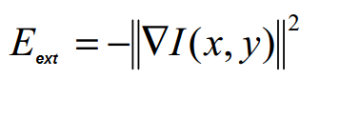
Active contours – Energy minimisation External energy

Slide 5
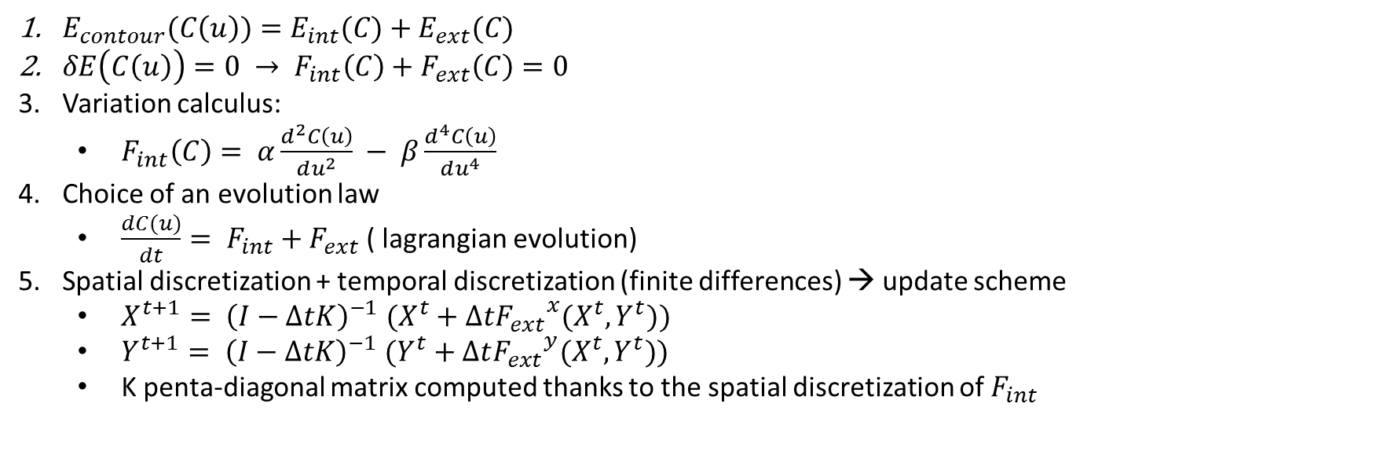
Active contours : Update scheme
$E_{contour}(C\left(u\right))=E_{int}(C)+E_{ext}(C)$
$δE\left(C\left(u\right)\right)=0 → F_{int}\left(C\right)+F_{ext}\left(C\right)=0$
Variation calculus:
$F_{int}\left(C\right)= α\frac{d^{2}C\left(u\right)}{du^{2}} − β\frac{d^{4}C\left(u\right)}{du^{4}}$
Choice of an evolution law
$\frac{dC(u)}{dt}= F_{int}+F_{ext}$ ( lagrangian evolution)
Spatial discretization + temporal discretization (finite differences) → update scheme
$X^{t+1}{= \left(I−ΔtK\right)}^{−1}(X^{t}+Δt{F_{ext}}^{x}(X^{t},Y^{t}))$
$Y^{t+1}{= \left(I−ΔtK\right)}^{−1}(Y^{t}+Δt{F_{ext}}^{y}(X^{t},Y^{t}))$
K penta-diagonal matrix computed thanks to the spatial discretization of $F_{int}$

Slide 6
GVF - Nico

Slide 7
VFC - Nico

Slide 8
VFC2 - Nico

Slide 9
Parametres de VFC - Nico

Slide 10
Analysis of active contours using VFC
Claims :
Large capture range
Better robustness to noise
Convergence in concavities
Good behavior on initialisation
Reduced computational costs
Variation of the kernel size
Comparison with GVF for impulse and additive gaussian noise
Test of the behavior with respect to concavities
Test of multiple initialisation

Slide 11
Initialisation - Nico

Slide 12
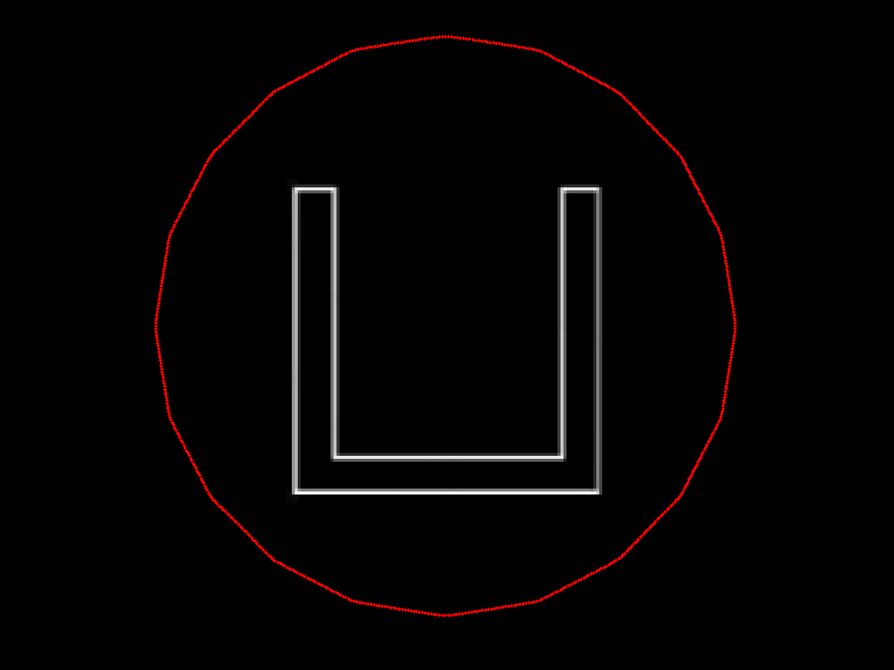
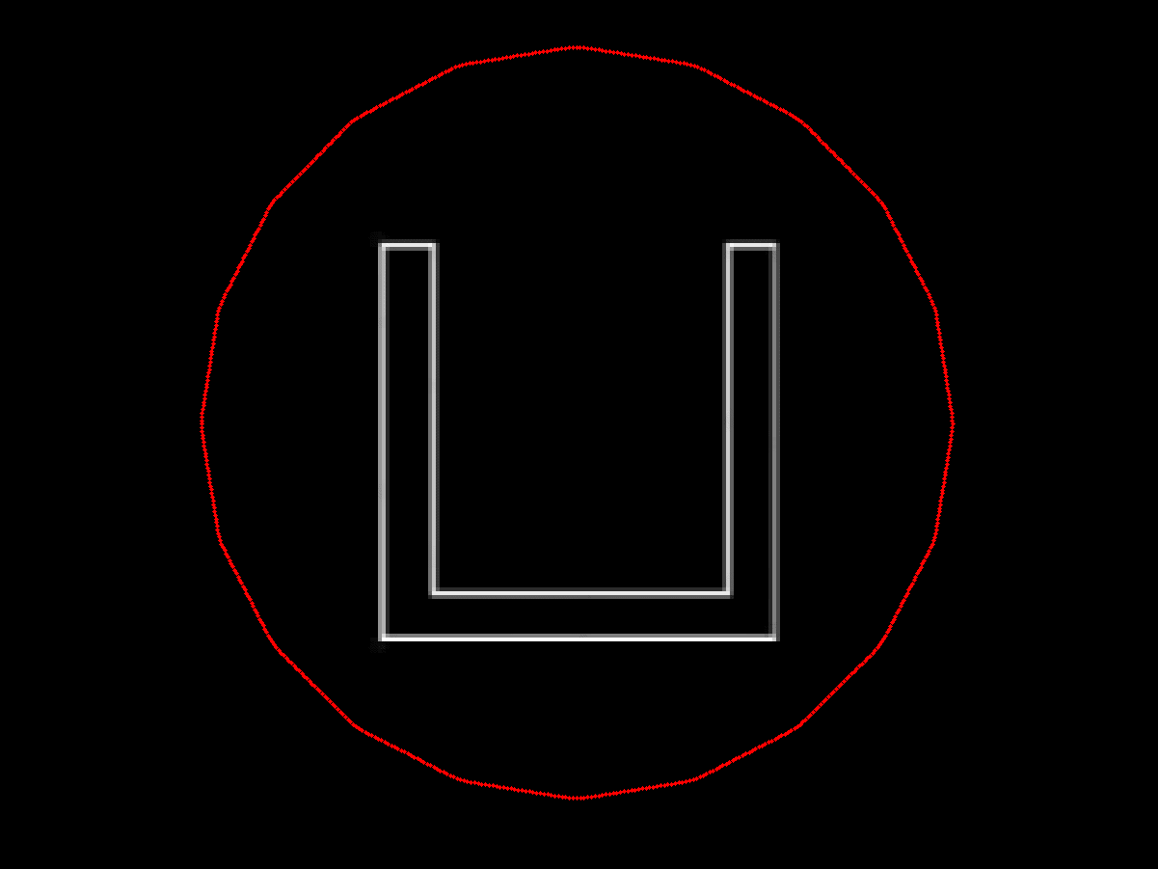
Convergence to concavities (1/2)
GVF
VFC

Slide 13
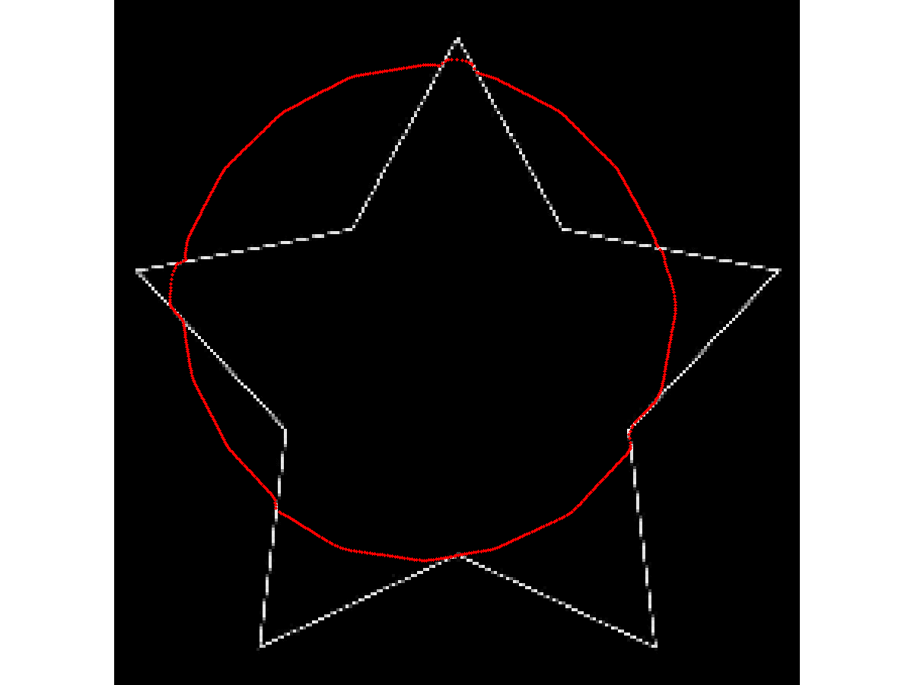
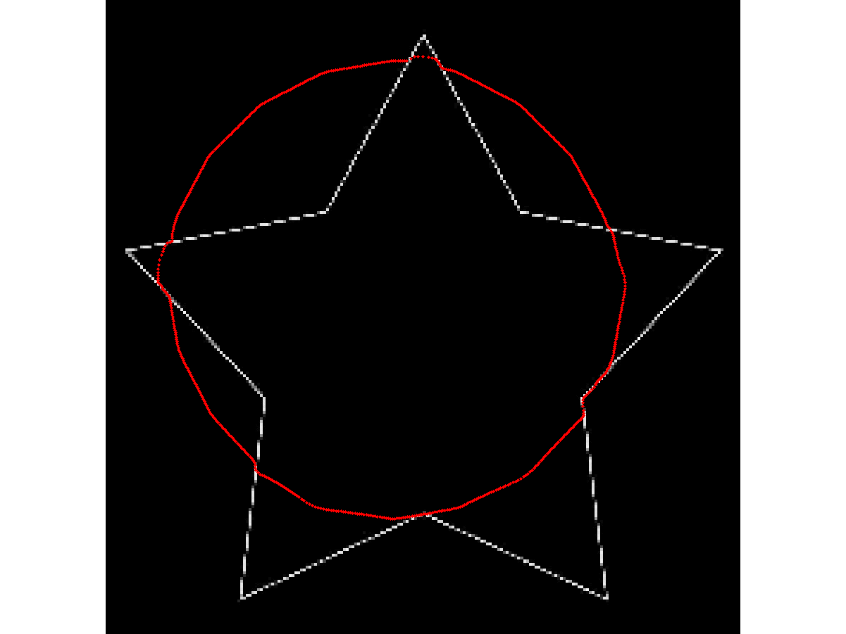
Convergence to concavities (2/2)
GVF
VFC

Slide 14
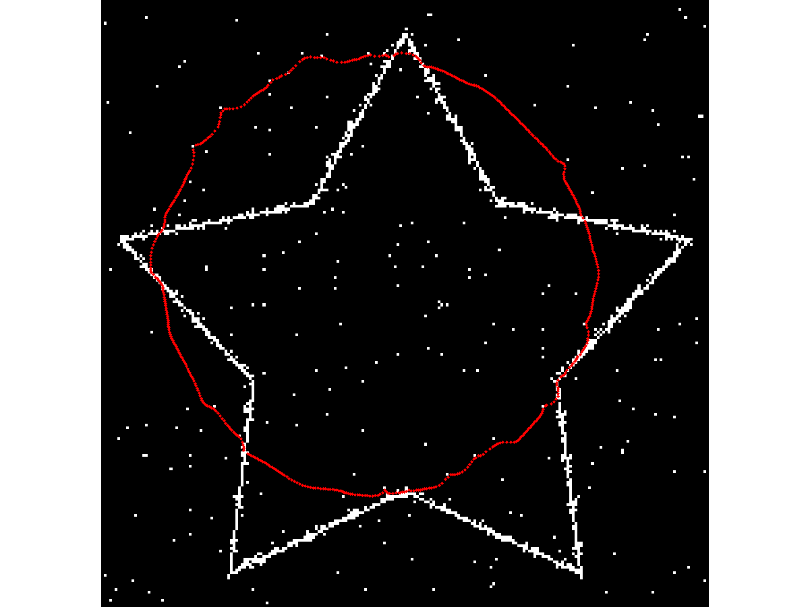
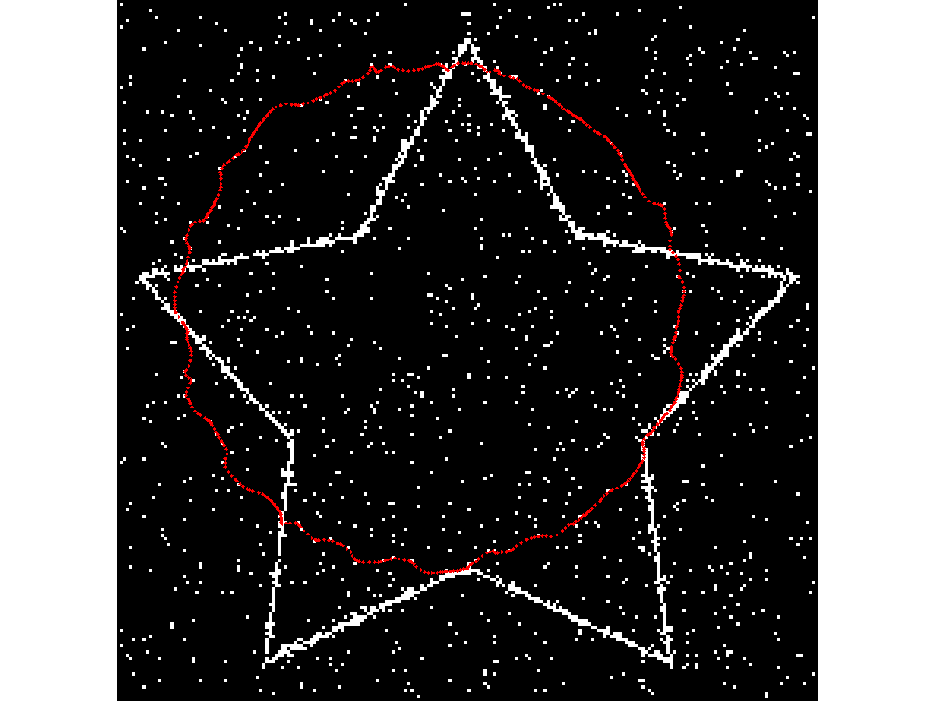
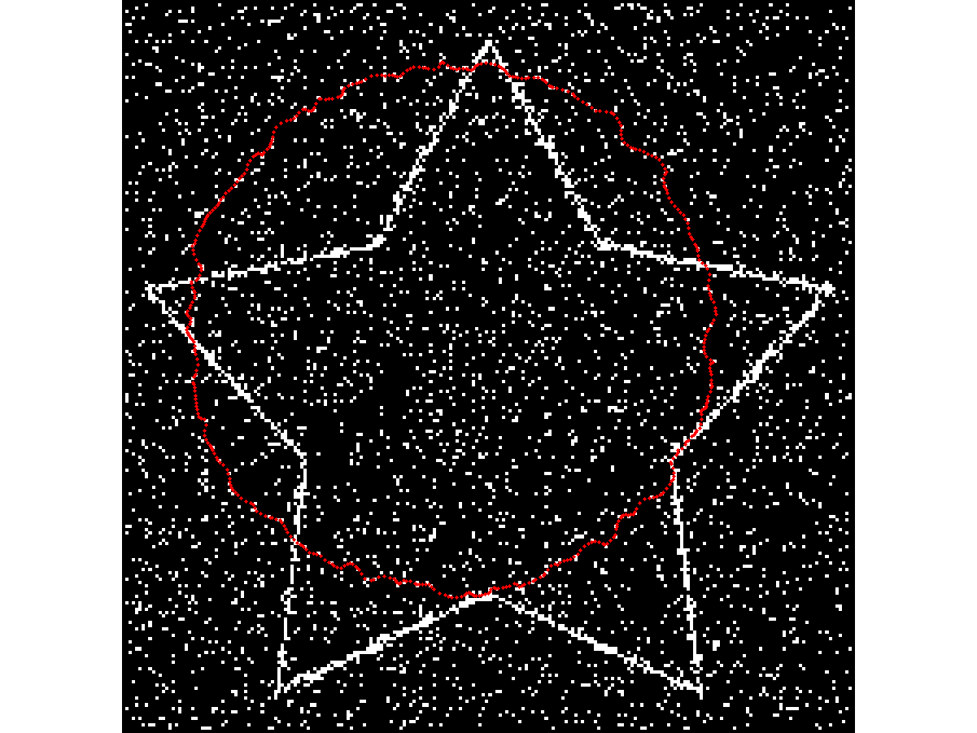
Robustness to noise : GVF with salt&pepper noise
1%
5%
15%

Slide 15
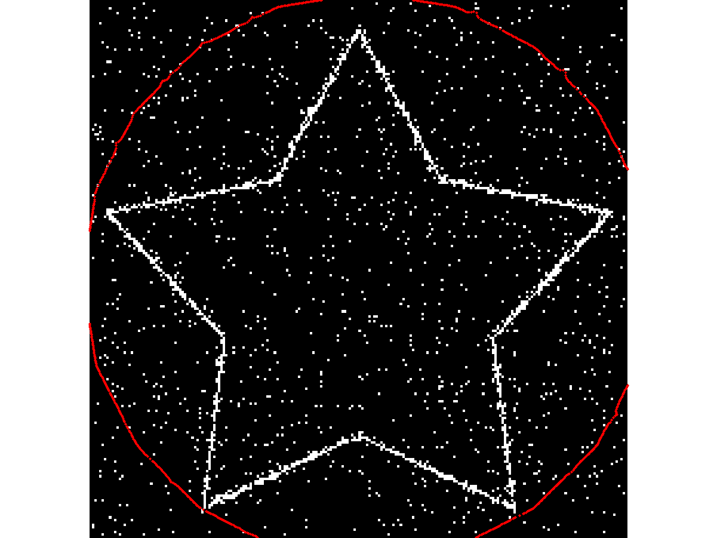
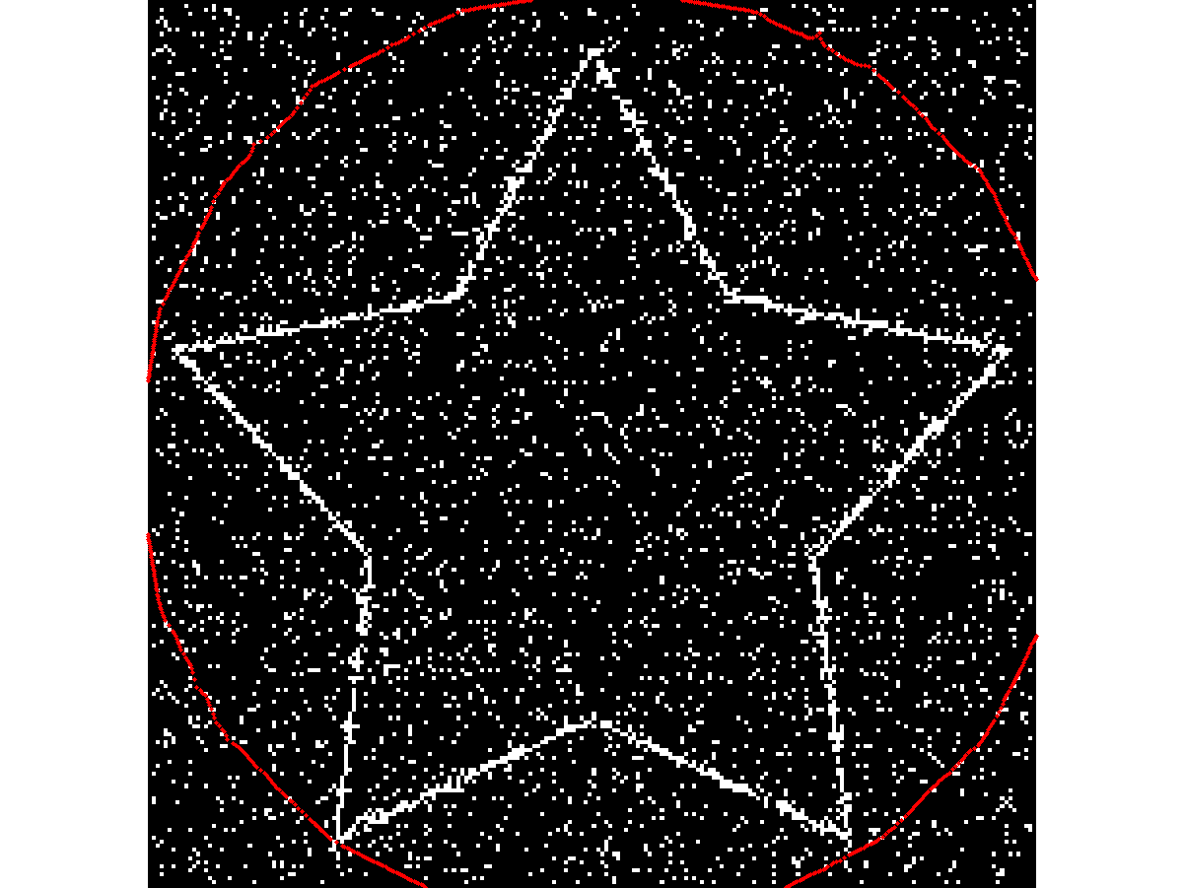
Robustness to noise : VFC with salt&pepper noise
5%
15%

Slide 16
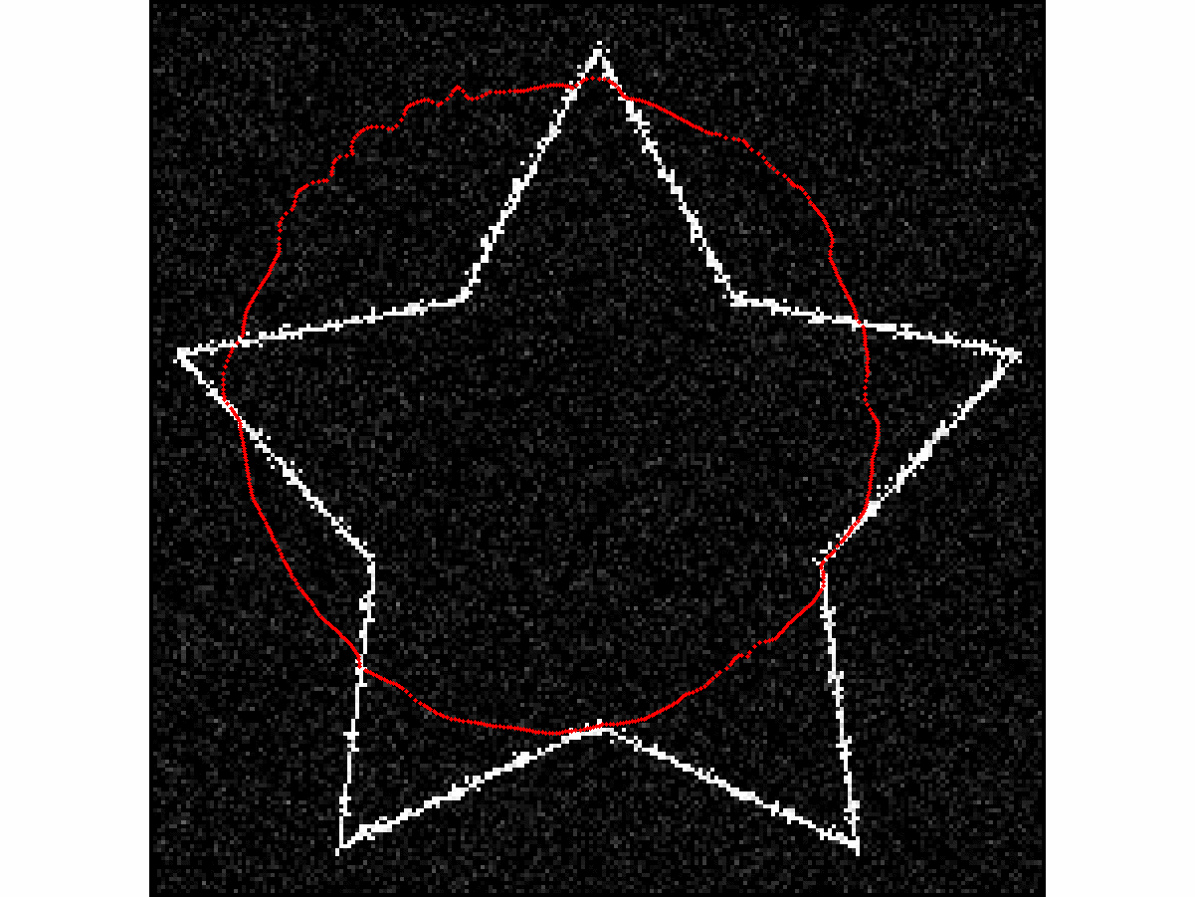
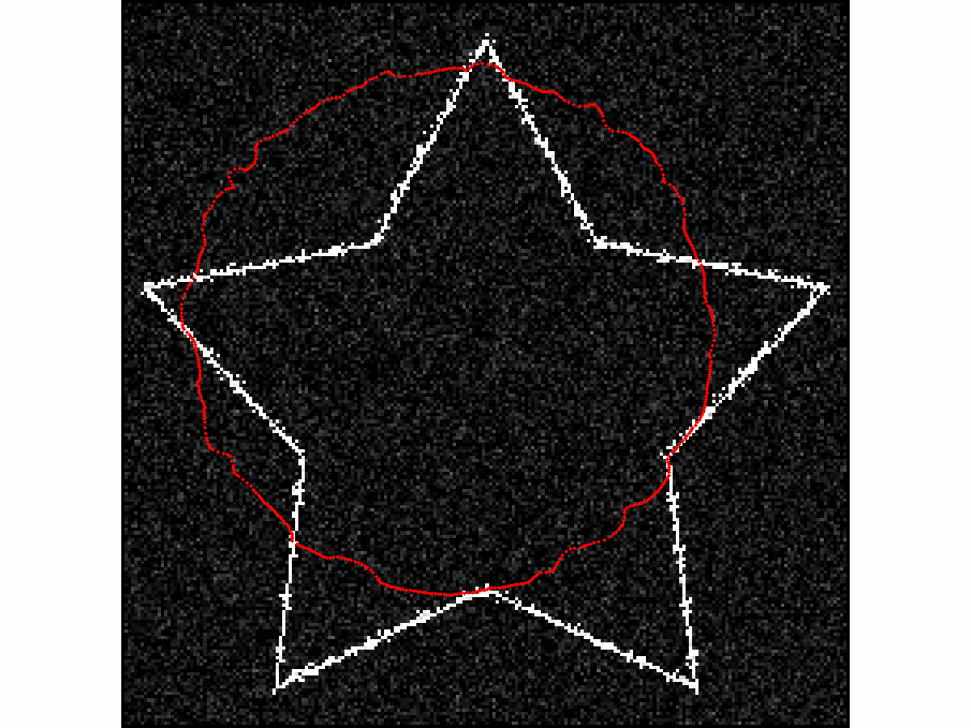
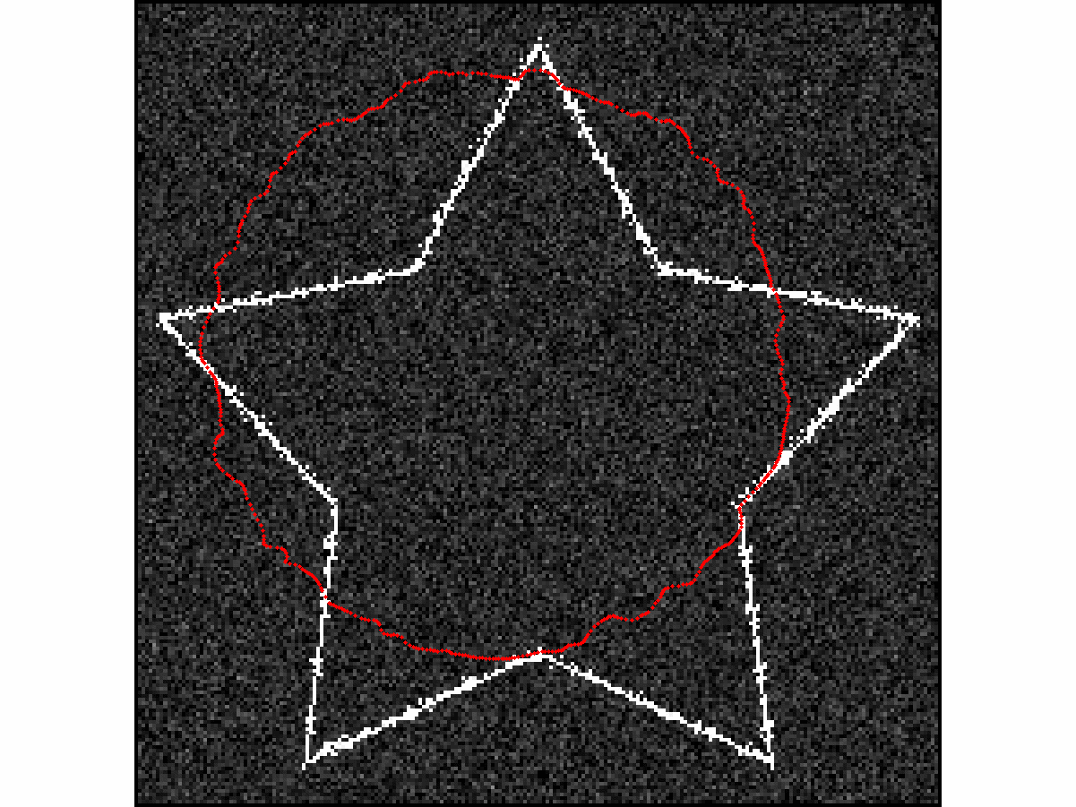
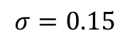
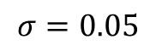
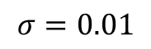
Robustness to noise : GVF with additive gaussian noise
$$σ=0.01$$
$$σ=0.05$$
$$σ=0.15$$

Slide 17
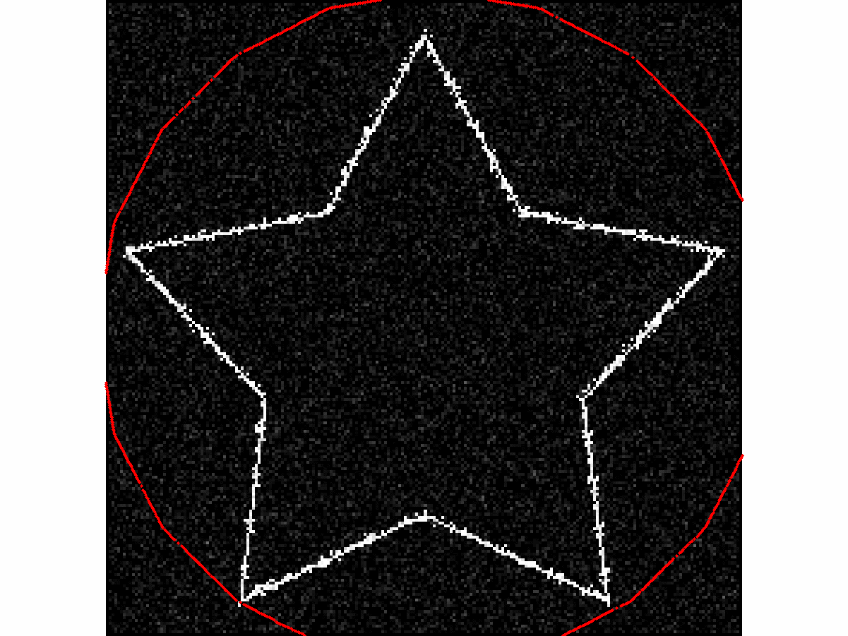
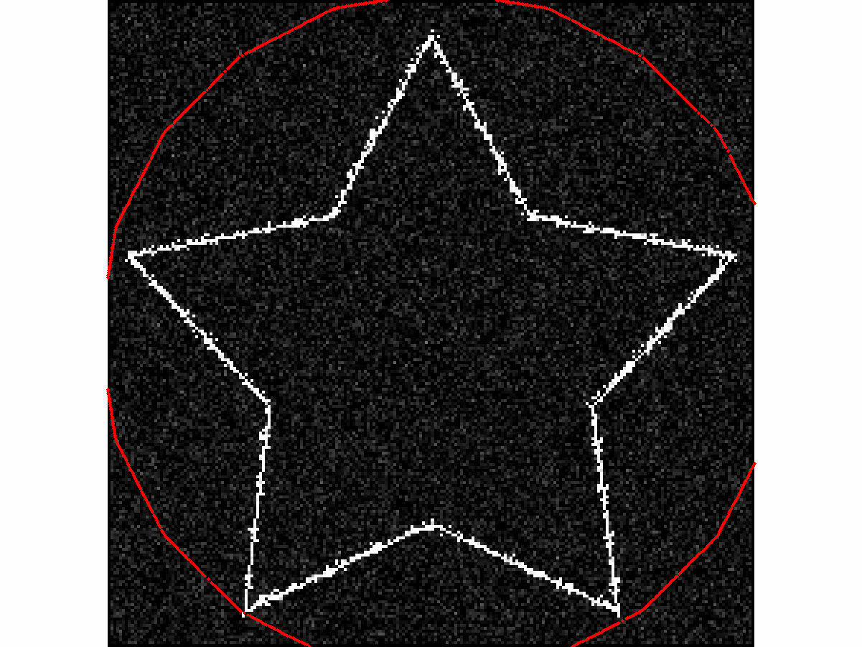
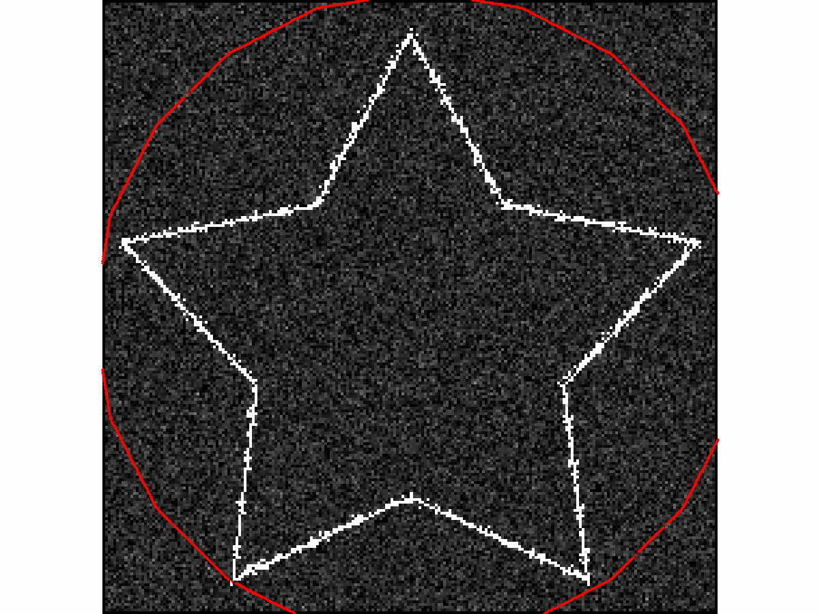
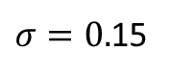
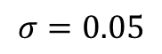
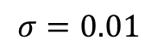
Robustness to noise : VFC with gaussian noise
$$σ=0.01$$
$$σ=0.05$$
$σ=0.$15

Slide 18
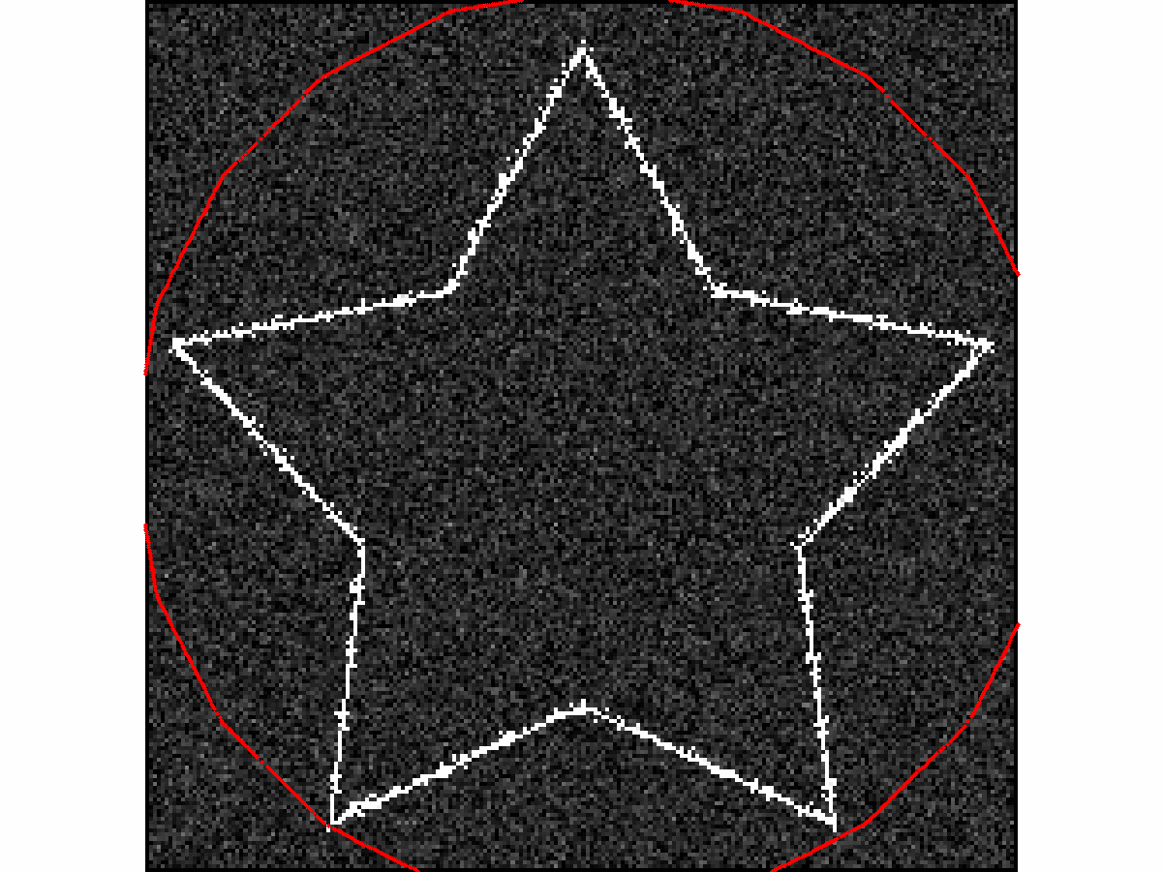
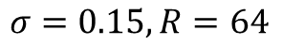
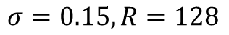
Robustness to noise : impact of the kernel radius ?
$$σ=0.15, R=128$$
$$σ=0.15, R=64$$

Slide 19
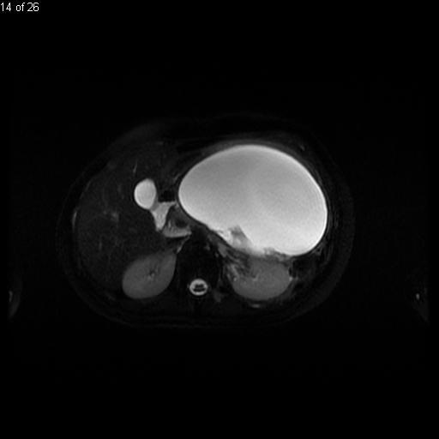
Conclusion
Capture range definition has been improved
Concavities converge property conserved
Better computational time
Better robustness to noise compared to GVF

Slide 20
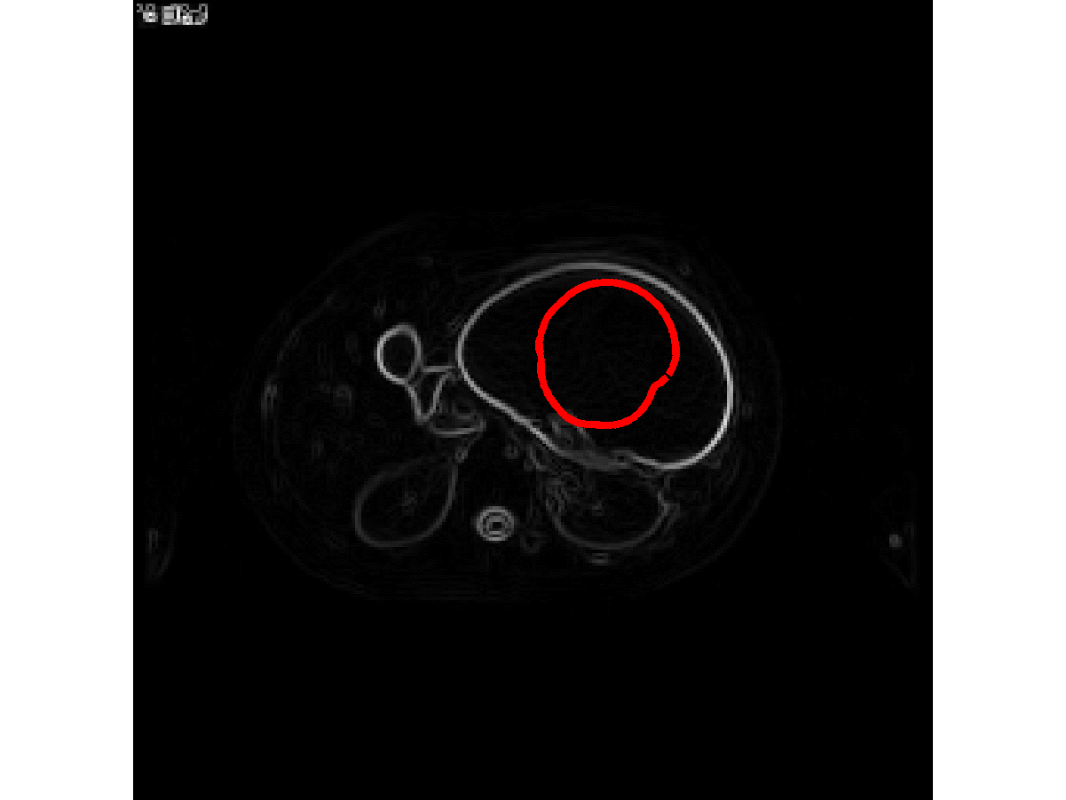
Conclusion
Capture range definition has been improves
Concavities converge property conserved
Better computational time
Better robustness to noise compared to GVF

Slide 21
Further work
Adaptative kernel
In time
With respect to the data
Multi-scale VFC to handle noise

